Slide 1
Unmasking Head and Neck Cancers
What You Need to Know to AID Early Detection
Dr Suman Kharkwal
Head Department of Surgical Oncology
ESI - PGIMSR, Basaidarapur, Delhi

Slide 2
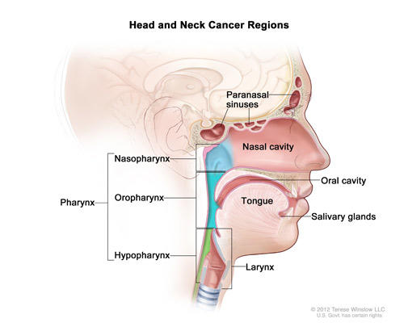
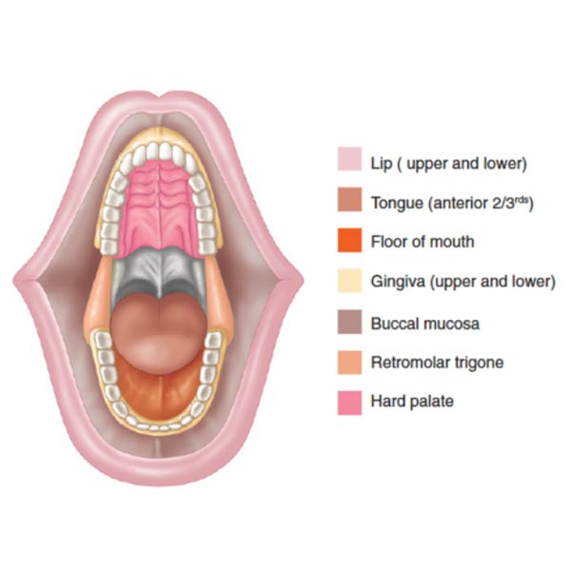
Introduction
What constitutes Head and Neck Cancers
Oral Cavity
Nose and Para nasal Sinuses
Larynx (Voice Box)
Pharynx
Salivary glands
Thyroid

Slide 3
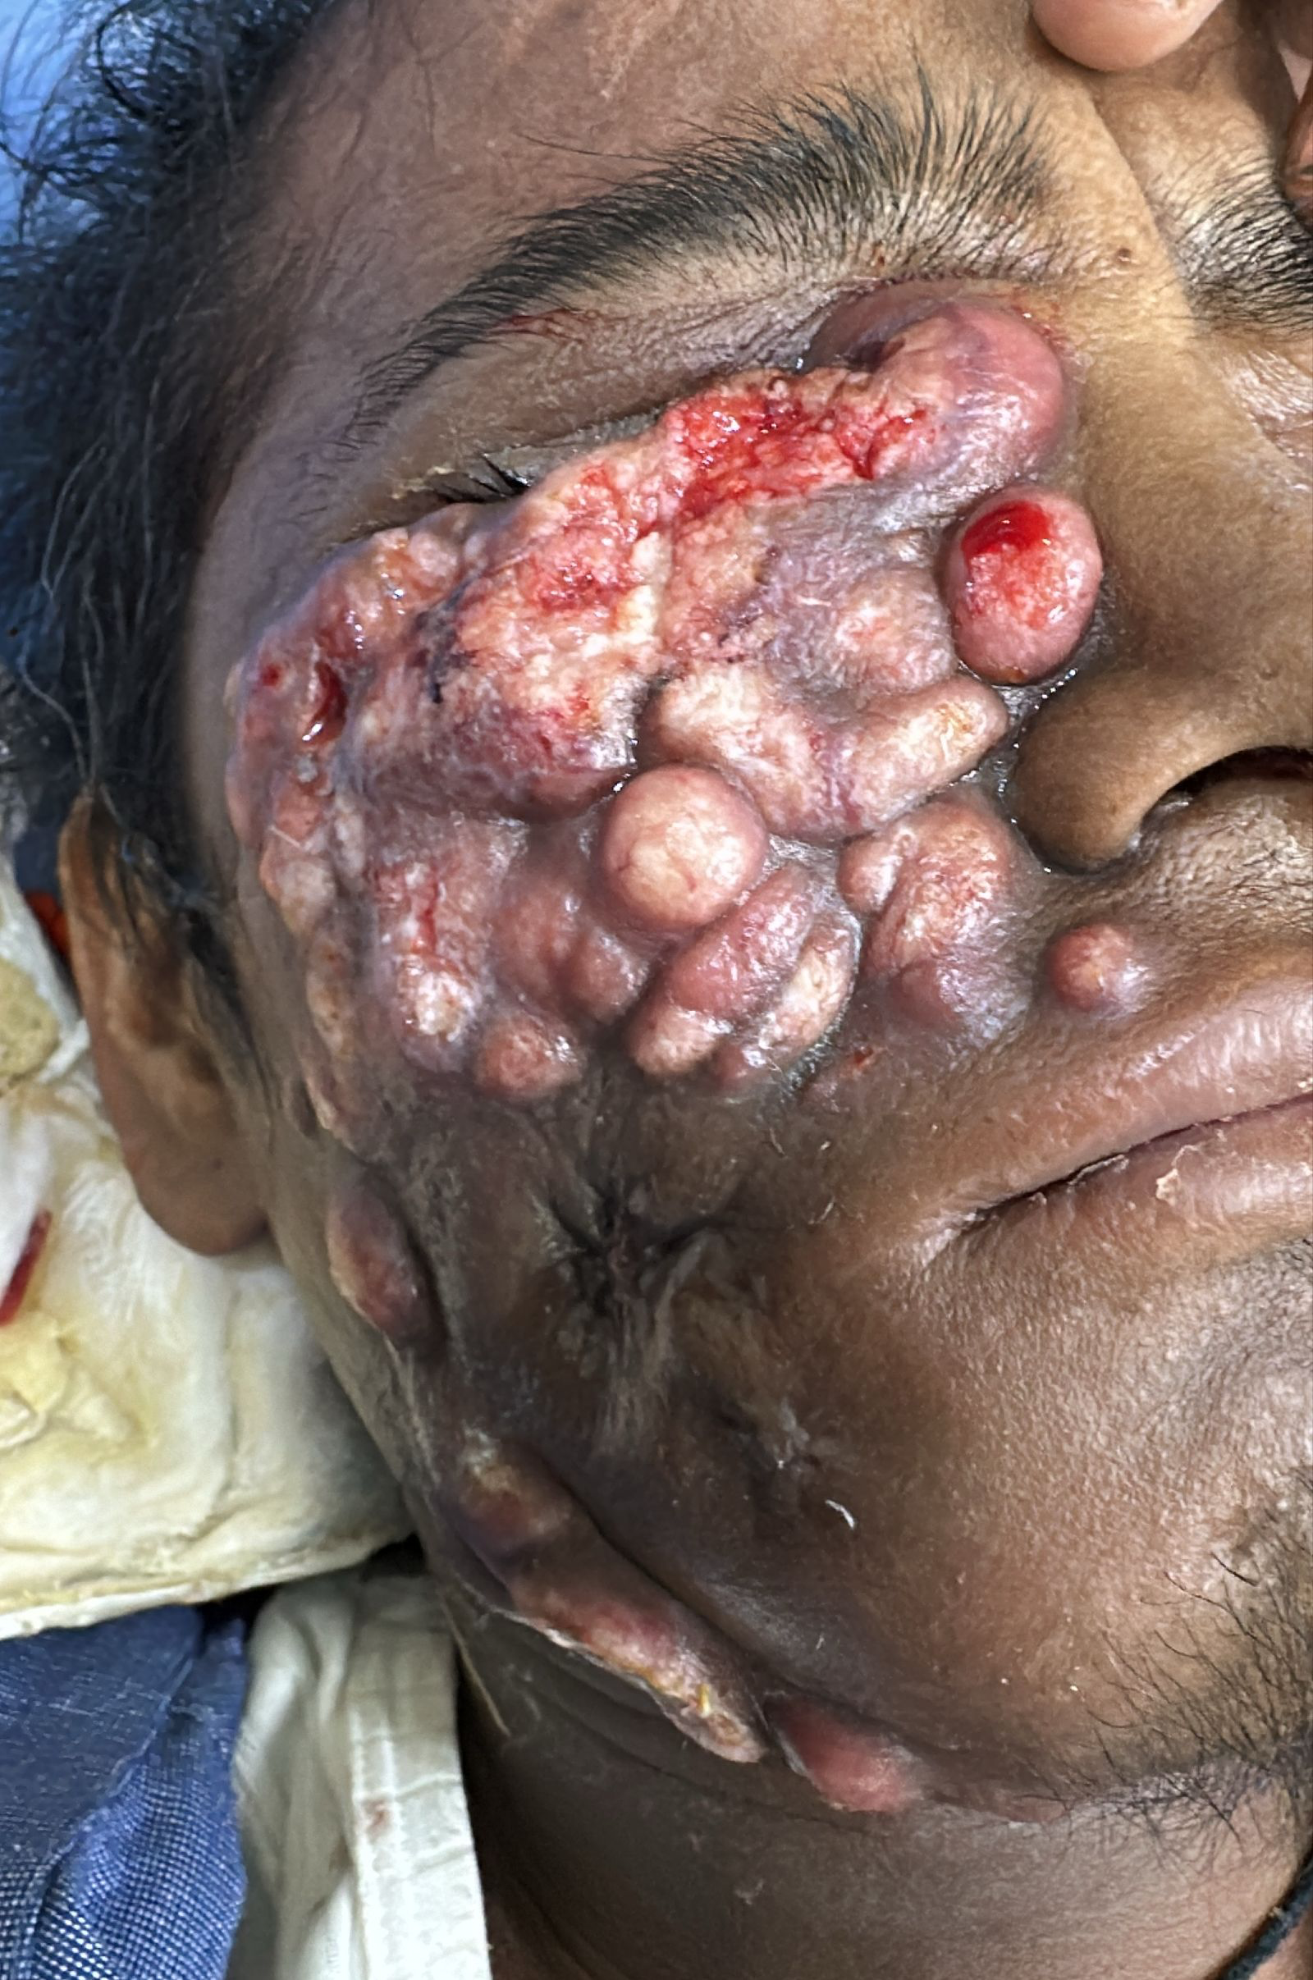
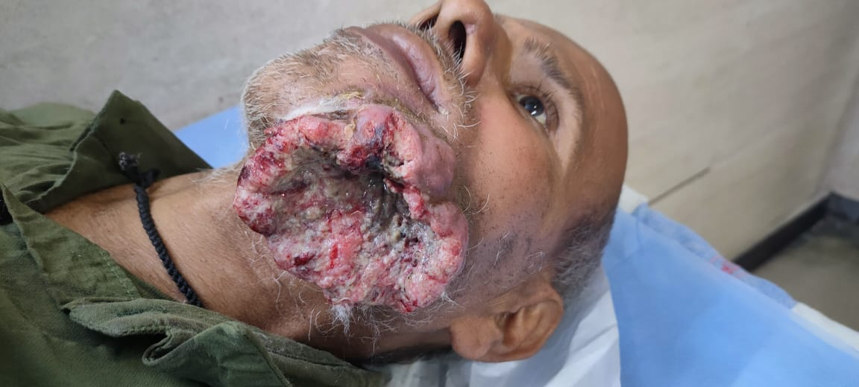

Why we need to talk about Head and Neck Cancers

Slide 4
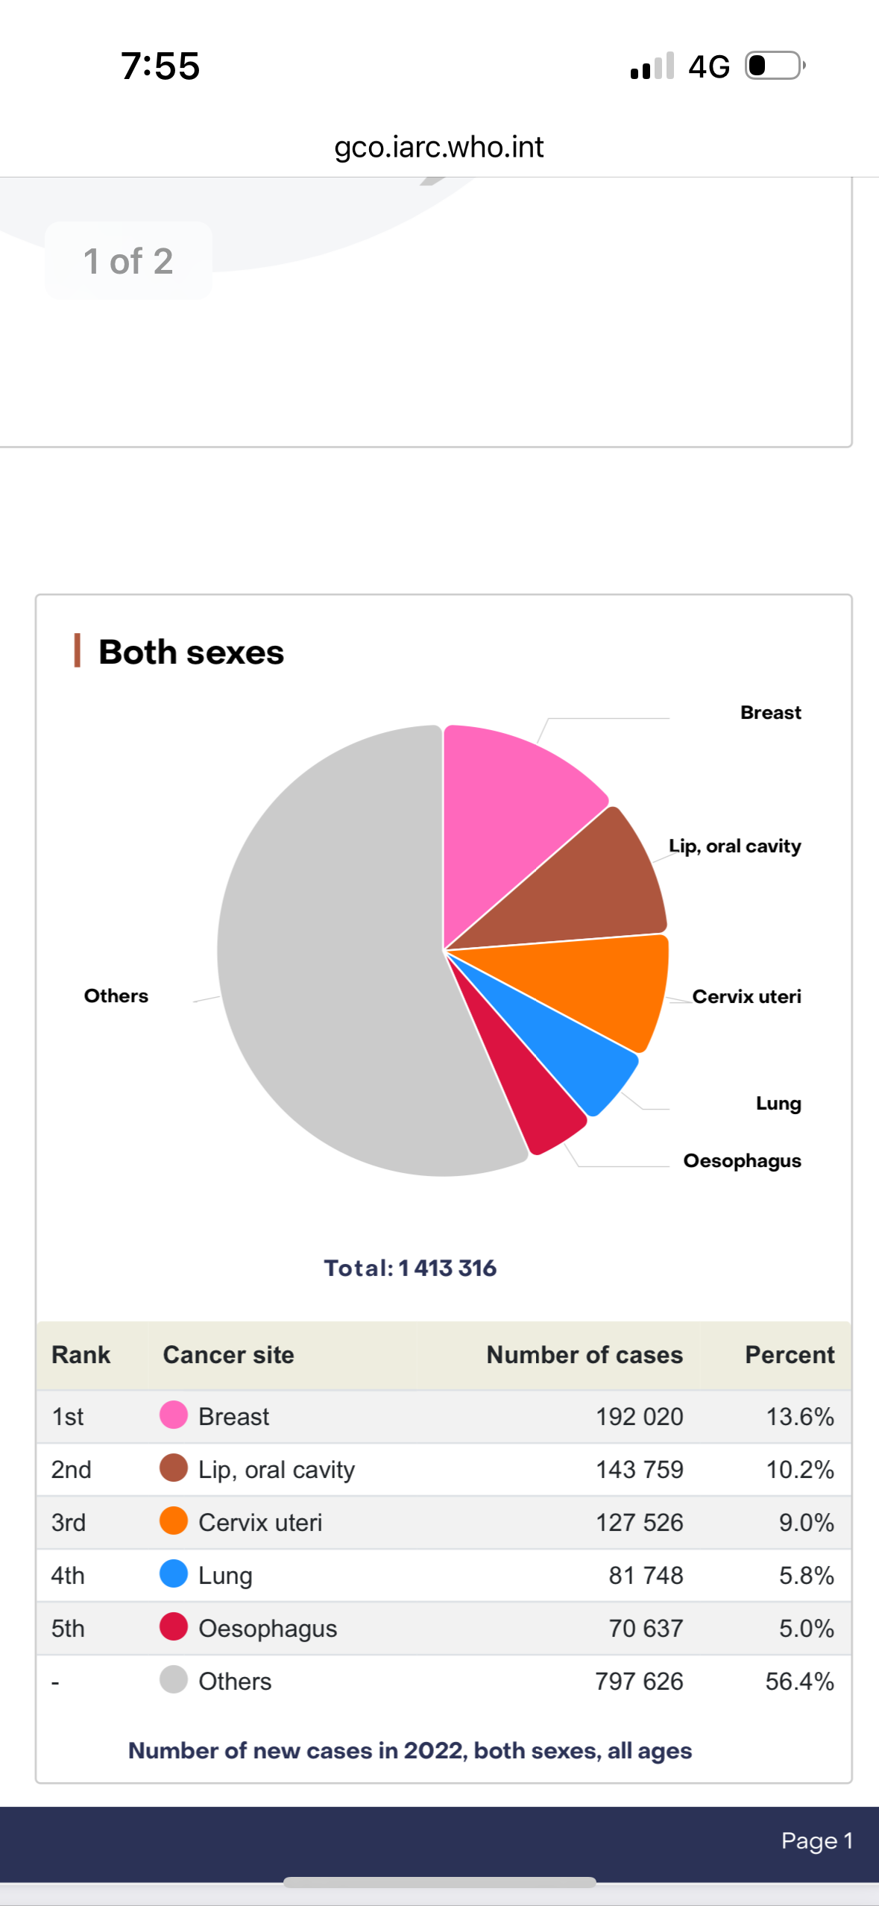
Need For Early Detection
India has become the Capital of Oral cancers
Latest Globocan Data 2022 India

Slide 5
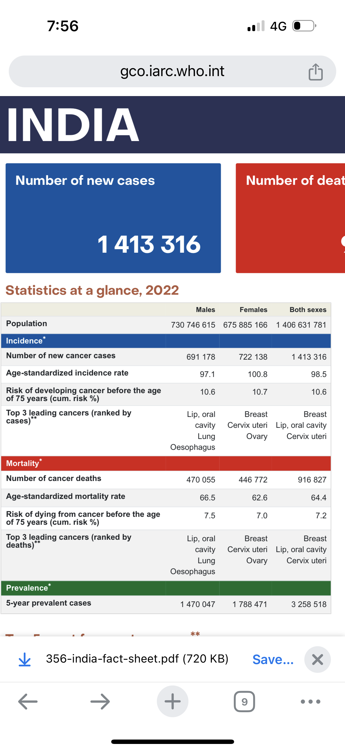
Need For Early Detection

Slide 6
Unmasking Head and Neck Cancers
The most accessible area of the Body
Early detection means
  Simple surgery
  Early return to normal life
  May not require post-surgery treatment ( Radiotherapy/ Chemotherapy)
  Chances of recurrence are lower
  The financial burden is less

Slide 7
Unmasking Head and Neck Cancers
Risk Factors
  Tobacco
  Alcohol
  Infections – HPV
  Constant Irritation - Sharp tooth
Known genetic syndromes
  Fanconi anemia and
  Dyskeratosis congenita,

Slide 8
Risk Factors
Precancerous Oral Lesions
Oral Leukoplakia
Oral Erythroplakia
Proliferative verrucous leukoplakia
Palatal lesion of reverse smokers

Slide 9
Unmasking Head and Neck Cancers
Preventive Measures
  Tobacco – The most common risk factor and also the Most Modifiable
  Good Oral Hygiene
  Healthy Lifestyle

Slide 10
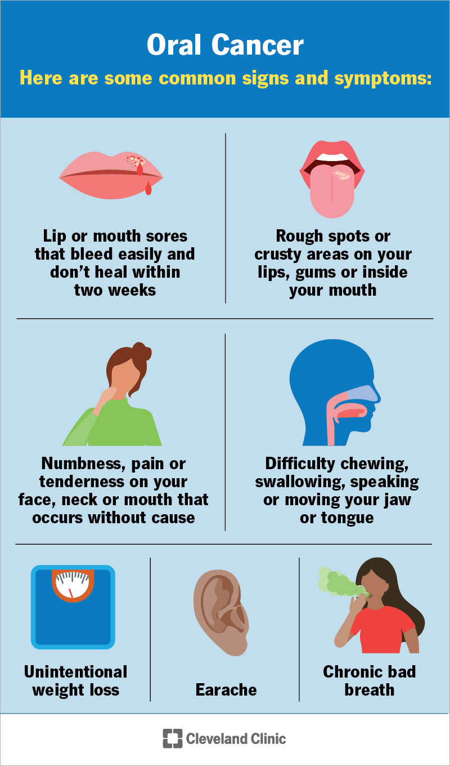
Unmasking Head and Neck Cancers
Signs and Symptoms

Slide 11
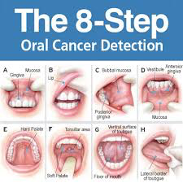
Unmasking Head and Neck Cancers

Slide 12
Management
THE MULTIDISCIPLINARY APPROACH
  Oral cancer is best managed with a multidisciplinary approach
The goals of treatment of cancers of the oral cavity are
  Cure of cancer
  Restoration of speech, mastication, and swallowing.
  To reduce the morbidity associated with treatment

Slide 13



CHOOSE YOUR HEROS WISELY
Do they really need this kind of money

Slide 14


