Slide 1

Head and neck cancer

Slide 2
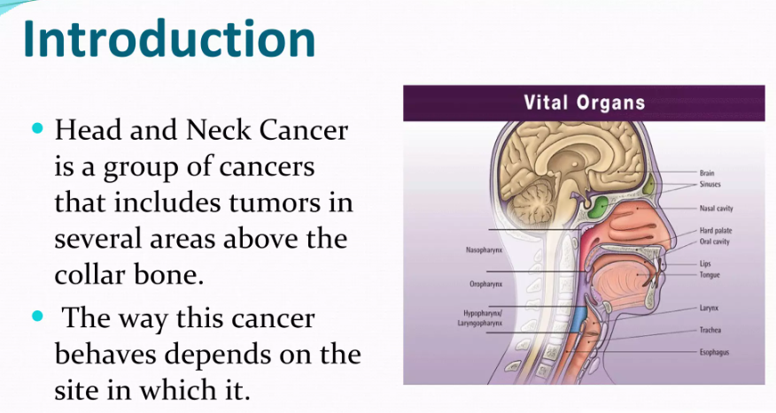
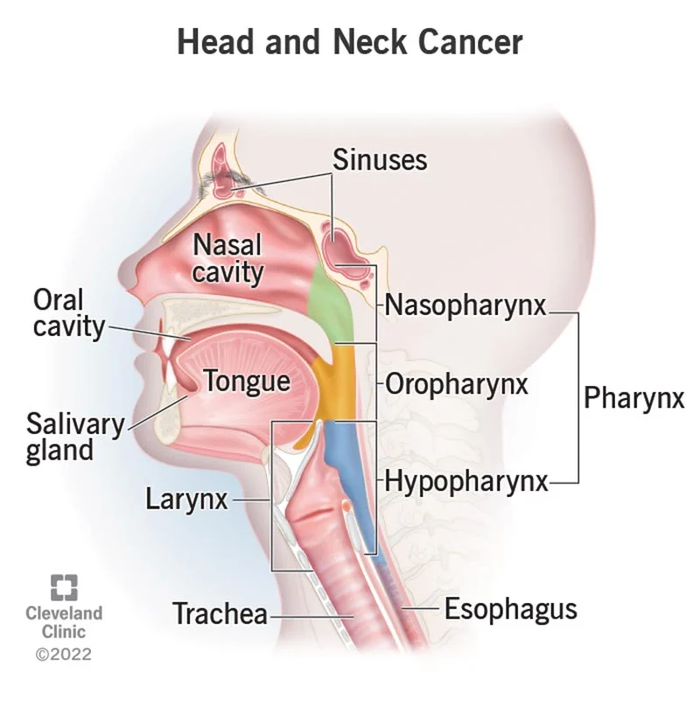

Slide 3
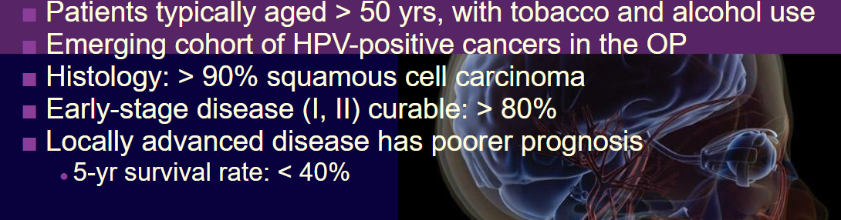
In India
Most common cancer in men and the fifth most common in women
India has the highest incidence of HNC in the world, with 20.9 cases per 100,000 men and 6.1 cases per 100,000 women
Lot of young patients

Slide 4
HPV associated cancer
Over the past 5-10 years, a cohort of nonsmokers or minimal smokers has emerged who are human papillomavirus (HPV) positive; these patients tend to have cancers of the oropharynx
Predominant histology has been and remains squamous cell carcinoma, and at least in the early stages of disease, these cases are highly curable with long-term survival rates of > 80%
Locally advanced disease has a much poorer prognosis with 5-year survival rates of < 40% and the majority of disease deaths in head and neck cancer are caused by uncontrolled locoregional relapse

Slide 5
Challenges
Socioeconomic constraints
Large patient population
Inadequate infrastructure
Diagnostic delays are also a problem, with a median total delay of 73 days
Patient is many times the sole bread erner

Slide 6
Another major challenge
Second primary cancer

Slide 7
Types of cancer
Types of Head and Neck Cancers:
  Oral Cavity Cancer: Occurs in the lips, tongue, gums, and lining of the mouth.
  Pharyngeal Cancer: Affects the pharynx, which is the tube inside the neck that leads from the nose and mouth to the esophagus.
  Laryngeal Cancer: Originates in the larynx, which contains the vocal cords.
  Nasal Cavity and Paranasal Sinus Cancer: Develops in the nasal cavity or the sinuses around the nose.
  Salivary Gland Cancer: Affects the salivary glands that produce saliva.

Slide 8
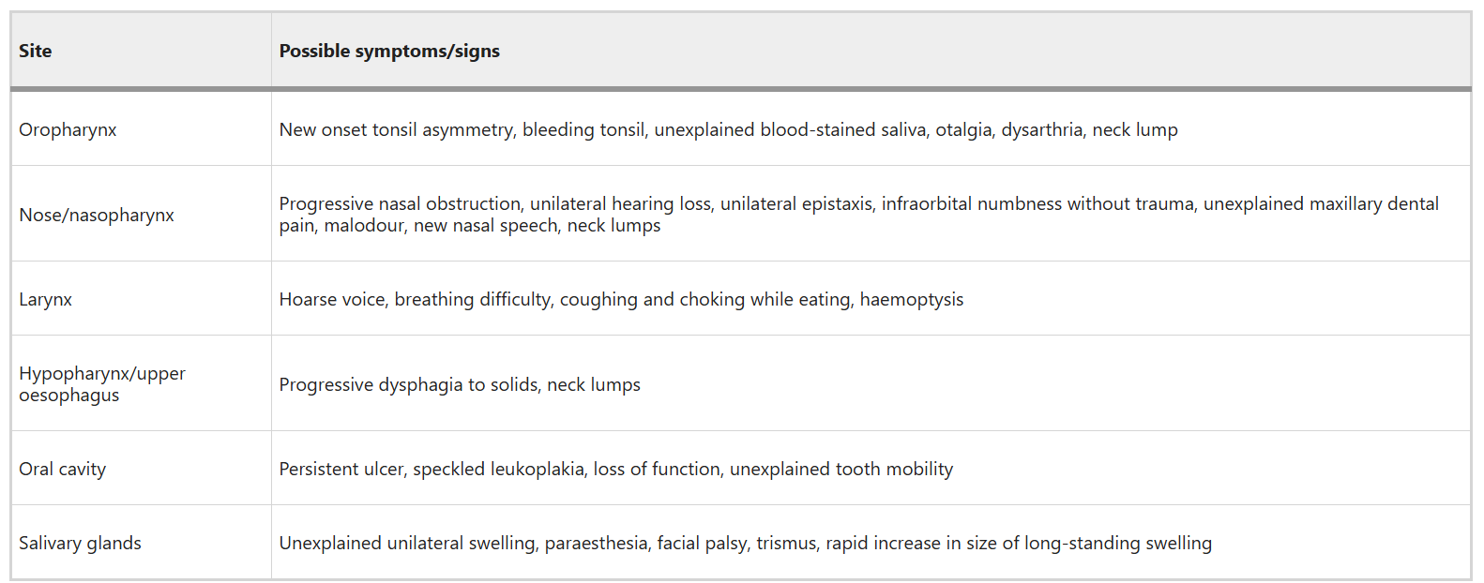

Slide 9
Management depending on location
&
Extent of the disease
Comorbidities

Slide 10
Diagnosis and extent
Diagnosis is confirmed by biopsy.
CT neck, CxR, If feasible triple endoscopy and or CT-PET scan to look for mets.

Slide 11
Outcomes
Stages I and II
  1/3 of patients
  Curative results: 60% to 80%
  SPTs: greater risk than recurrence
Stages III and IV
  2/3 of patients
  Multimodal treatment
  40% to 80% local recurrence
  10% to 30% distant disease

Slide 12
MDT

Slide 13
Treatment options
Surgery
Radiation therapy
Chemotherapy
Immunotherapy
Targete therapy
Dietician

Slide 14
Surgery
Dedicated head and neck cancer surgeon
Every case is discussed in MDT
Important is surgical resection of primary site with reconstruction as needed and lymph node dissection of the draining lymph nodes
Sometimes chemotherapy is given before surgery to facilitate surgical resection by achieving down sizing
Preferred modality for cancer of anterior 2/3 of tongue, cheek, alveolus
Sometimes post operative course requires further treatment using radiation or chemotherapy

Slide 15
Radiation therapy
To put it simply, it is rays to kill cancer cells
At many sites, it is not feasible to remove cancer by surgery
Hence radiation is used to burn cancer cells
Sometimes chemotherapy is given before or during radiation to improve cancer killing
Preferred modality for nasopharynx, Oropharynx, posterior 2/.3 of tongue including base of the tongue

Slide 16
MDT
Small lesion at an area easily amenable to surgery e.g.lip, cheek gum, tongue
Large lesion at a site amenable to surgery
Advance cancer or metastatic caners
Lesion at a site where surgery not feasible
Surgery and assessment of postoperative histopathology/biopsy sample
Surgery includes excision of lesion with clear margins and draining lymph nodes
Chemotherapy followed by surgery
Then radiation or chemoradiation is done
To be treated with palliative intent and prolong life
Chemotherapy
Immunotherapy
Target therapy
Depending on extent of disease in surgical specimen , post operative chemotherapy or chemo-radiation is done
Usually given post operative chemo radiation also

Slide 17
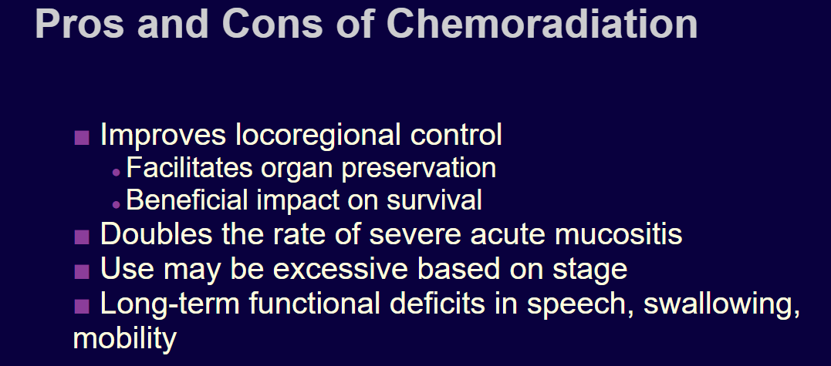
Notes:
Concomitant chemoradiation clearly improves locoregional control, can facilitate organ preservation, and has a beneficial impact on survival. But there are negative effects as well: The incidence of severe acute mucositis goes up 2-fold and in some cases 3-fold; there is often a tendency to use this approach excessively, sometimes in patients with earlier-stage disease; and there can be long-term functional deficits in speech, swallowing, and mobility even with preservation of head and neck organs.
​

Slide 18
Long term complications
Sores
Thyroid dysfunction
Mouth dryness
Disfigurement
Inadequate mouth opening

Slide 19
Systemic therapies
More role in metastatic cancers
Before surgery
After surgery
During radiation therapy

Slide 20
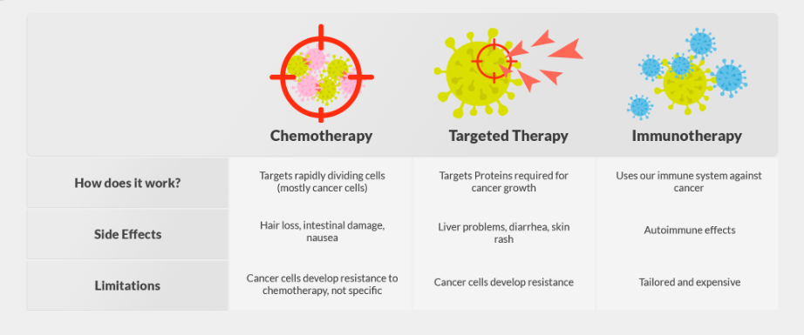
Difference between chemotherapy immunotherapy and targeted therapy

Slide 21
Systemic therapy
Chemotherapy agents :
Paclitxel
Cisplatin or carboplatin
Docetaxel
Methotrexate
Gemcitabine
capecitabine

Slide 22
Immunotherapy
Pembrolizumab
Nivolumab
Works best in PD L 1 positive population

Slide 23
Target therapy
Cetuximab
Nimotuzumab
Gefitinib/ erlotinib/ afatinib

