Slide 1

CANCER CARE
Debunking Myths and Misconceptions
By
Vandana Mahajan
Patient Advocate

Slide 2


Slide 3
Cancer is a death sentence
Cancer is contagious
Biopsy /Surgery will cause the cancer to spread
If someone in my family has cancer I will have it too
If no one in my family has cancer I will not have cancer
Chemotherapy causes death
Eating sugar will cause cancer to grow
Bad thoughts or negative attitudes will cause me to develop or die from cancer
Cancer happens due to bad karmas
Bad thoughts or negative attitudes will cause me to develop or die from cancer

Slide 4
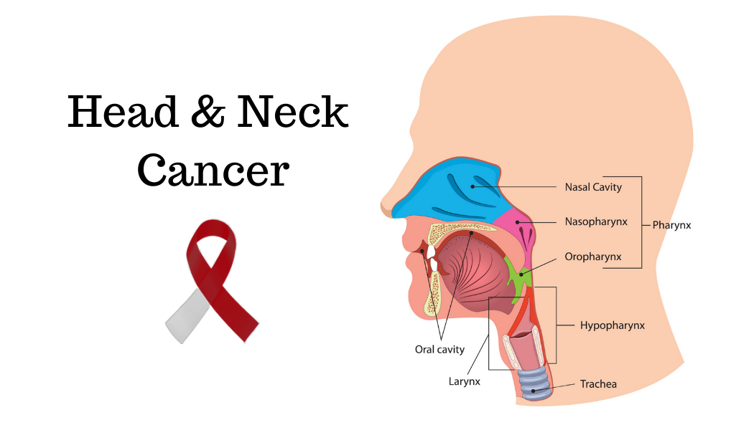
Myths specific to Head and Neck Cancers
Head and neck cancer is only caused by smoking and drinking
Treatment will have a permanent effect on my ability to speak, breathe, and swallow
Head and neck cancers are always deadly

Slide 5

Why Debunk the myths?
Myths and misconceptions about cancer treatment
frequently fog the minds of patients and their families,
resulting in disorientation, fear, and, in some cases,
misguided decisions
Misinformation always leads to more significant problems that are often irreversible.
The importance of factual information cannot be overstated, especially when dealing with a life-threatening illness

Slide 6
Barriers faced by those diagnosed with Cancer
Stigma
Myths land misconceptions
Societal perception
Financial Constraints
High costs of treatment.
Lack of insurance schemes
Inequitable access to insurance schemes
OOPE
Lack of infrastructure
Cancer care services concentrated in metro cities.
Rural areas lack access to specialized facilities.
Delay in diagnosis
Primary healthcare centers (PHCs) are not equipped for early detection.
Symptoms often disregarded or misdiagnosed.

Slide 7
Misconceptions about navigating health care system
Follow ups are not needed/ Delay in follow ups
I am too young for cancer screening
I feel healthy do I do not need check ups
Cancer cannot happen to me
Health insurance is not needed for children, young and healthy people
Palliative care is only for those who are dying
If I seek emotional support I will be labelled as MAD
HPV vaccine is only for females
Terminal cancer means being abandoned
Disfigurement means I should stay home because the people will laugh at me
I will not talk of my cancer journey because of the stigma and societal perception
I have to be strong all the time

Slide 8
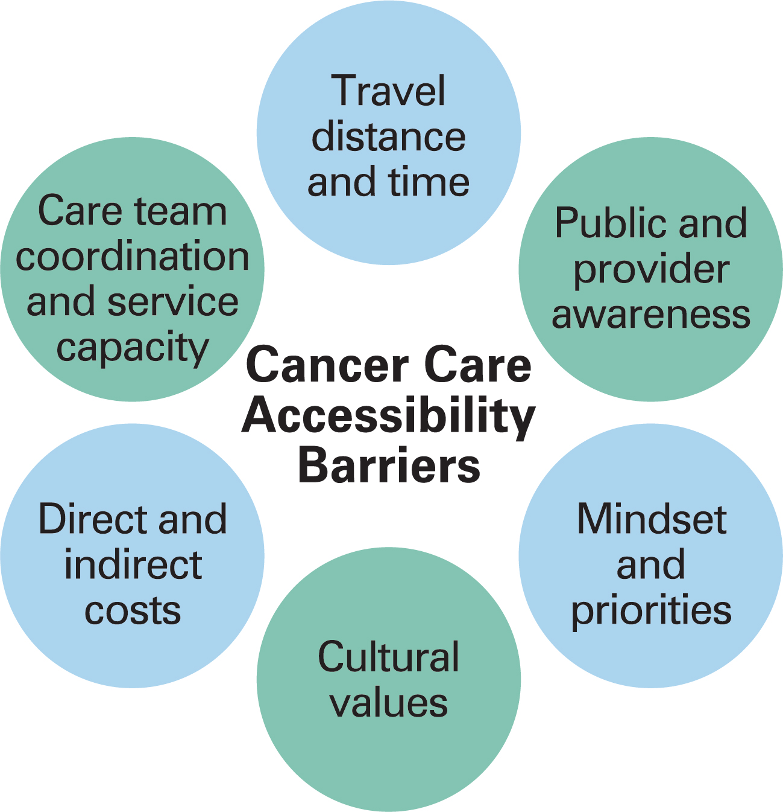
PERSONAL EXPERIENCE

Slide 9

Cancer is not a WAR- it is a disease in which some people are cured and some are not.

